Slide 2

Unit 8: Creating and Using Forms

Slide 3
Lesson Objectives
After completing this lesson, you should be able to:
Describe an application form in Oracle APEX
List the different types of application forms that you can create in Oracle APEX
List the different wizards you use to create forms
Create an editable interactive grid
Create a simple form and link a report to this form
Create the following types of master detail forms:
Stacked
Side by Side
Drill Down
Modify a form

Slide 4

Understanding Forms in Oracle APEX
Forms are application components that are used to manipulate database objects
You can create forms either manually or by using wizards
You can create a form as a:
New page in an application
Region on an existing page in an application
Notes:
Forms are application components that are basically used for data input from end users. An application form takes input from an end user and saves it into the Oracle Database when they submit the page by clicking Apply Changes or Save. For example, you use a form to insert data in to EMPLOYEES table.
Forms are made up of fields (called items) which can be selected from the multitude of built-in types (such as text fields, text areas, radio groups, select lists, check boxes, date pickers, and popup list of values). Developers can also create their own custom item types using plug-ins.
Using wizards, you can easily create forms on tables or on a stored procedure. These wizards provide automatic management of insert, update, and delete. Once you create a form, you can rearrange form fields (called items) using a visual representation, enabling you to quickly achieve the layout you want.
Some forms enable users to update a single row in a table, while other forms enable users to update multiple rows in a table. You can create a form either as a new page in an application or as a region on an existing page.

Slide 5
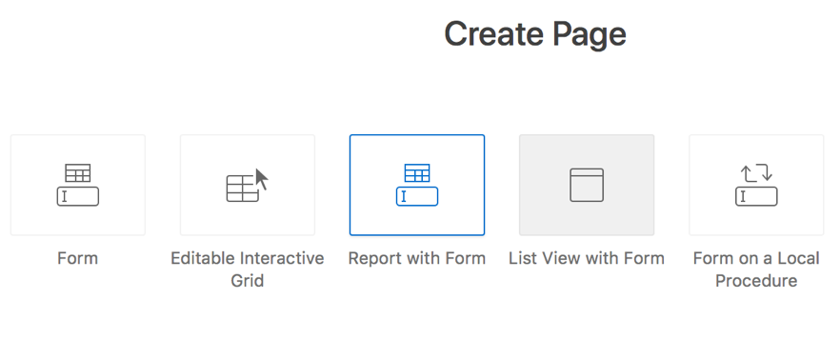
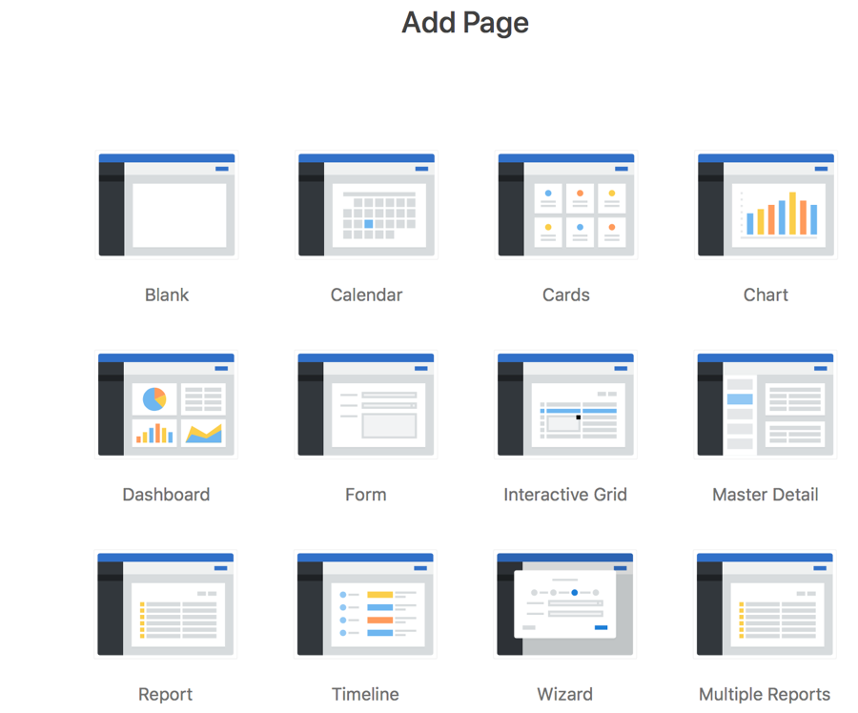
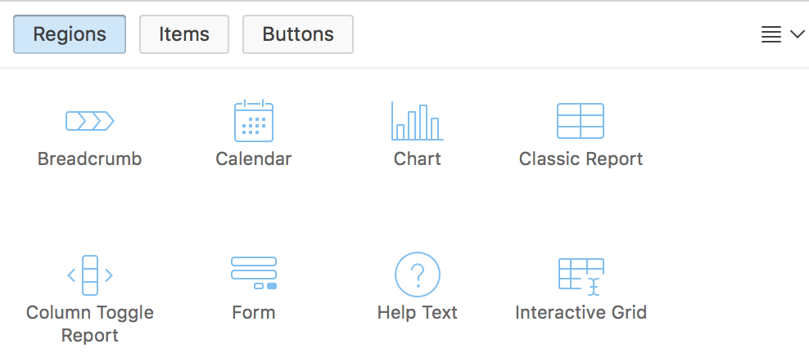
Developing Forms in Oracle APEX
Using the Create Page Wizard
Using the Create Application Wizard
Creating a Form region in Page Designer
Notes:
You can create forms using a number of wizards including the Create Application wizard and the Create Page wizard. You can also create a Form region in the Page Designer. Oracle APEX allows you to create multiple forms on your application page. The slide shows the three ways that you can create a form in your application.
Create Page wizard: The easiest way to create a form is to use the create page wizard. You learn the different form options available with the create page wizard in the next slide. Using the Create Page wizard, you can create a form on an external data source.
Create Application wizard: When creating a database application, you can create three basic form types: editable interactive grid, form on a table, or a master detail.
Create a Form region in Page Designer: In the Page Designer, you can drag and drop a form region from the gallery. Alternatively, under Rendering, right-click Regions and select Create Region to create a form region type. You learn how to create a form region later in this lesson.

Slide 6
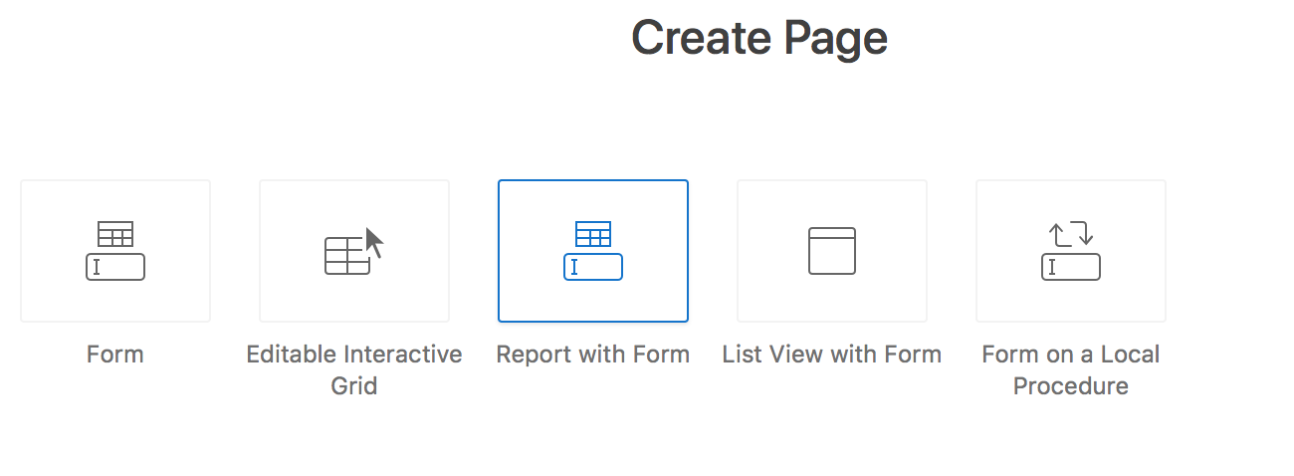
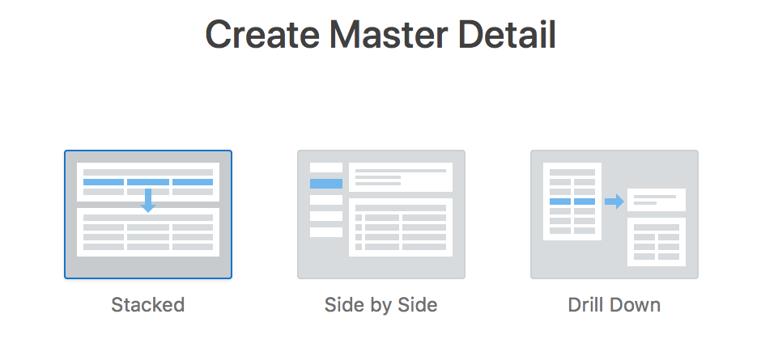
Understanding Form Types
Notes:
You use the Create Page wizard to create a wide variety of forms. Using the Create Page Wizard creates a complex form region which includes multiple form items and processes. Although you can create a region directly in the Rendering tree or drag a region from the Gallery, these approaches will not create these additional components.
The slide lists the form types you can create using the Create Page Wizard.
In the Create Page wizard, if you select Form for page type, you can choose any of the following form types:
Form: Creates a form that enables users to update a single row on the specified data source, which can be a table, SQL Query or Web Source Module.
Editable Interactive Grid: An interactive grid presents users a set of data in a searchable, customizable report. In an editable interactive grid, users can also add to, modify, and refresh the data set directly on the page. Functionally, an interactive grid includes most customization capabilities available in interactive reports plus the ability to rearrange the report interactively using the mouse.
Report with Form: Creates a report and form based on the data source you specify. For the report, you choose a report type (Interactive Report, Interactive Grid, or Class Report). This wizard does not support tables having more than 127 columns. Selecting more than 127 columns generates an error.
List View with Form: Creates a form and list view that enables users to update a single row in a database table. You choose the table on which to build the form and select the column to be used for displaying text in the List View.
Form on a Local Procedure: Builds a form based on stored procedure arguments. Use this approach when you have implemented logic or Data Manipulation Language (DML) in a stored procedure or package.
In the Create Page wizard, if you select Master Detail for Page Type, then can choose any of the following types:
Stacked
Side by Side
Drill Down
You learn more about an editable interactive grid and master detail later in this lesson.
For more information about form options, see Oracle Application Express App Builder User’s Guide.

Slide 7
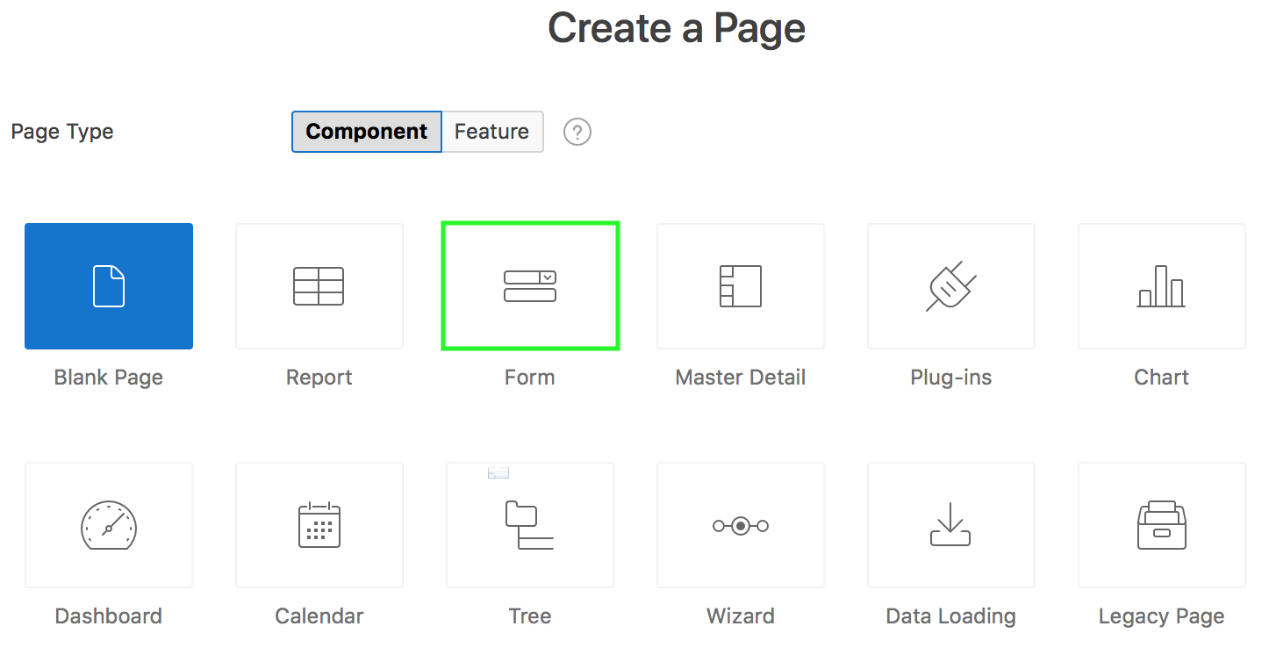
Creating a Form using the Create Page Wizard
Notes:
To create a form using the Create Page Wizard, perform the following steps:
On the Workspace home page, click the App Builder icon.
Select an application.
Click Create Page.
For Create a Page:
Page Type - Select Component and then select either Form or Master Detail.
If you select Form, select a form type:
Form
Editable Interactive Grid
Report with Form
List View with Form (Optimized for mobile apps)
Form on Local Procedure
If you select Master Detail, select a type:
Stacked .
Side by Side
Drill Down
Click Next.
What appears next depends upon the form you select. Follow the on-screen instructions.

Slide 8
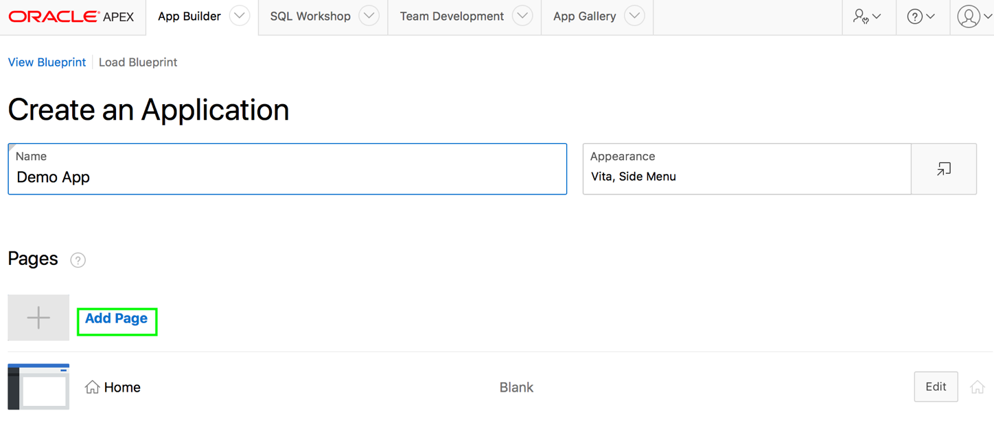
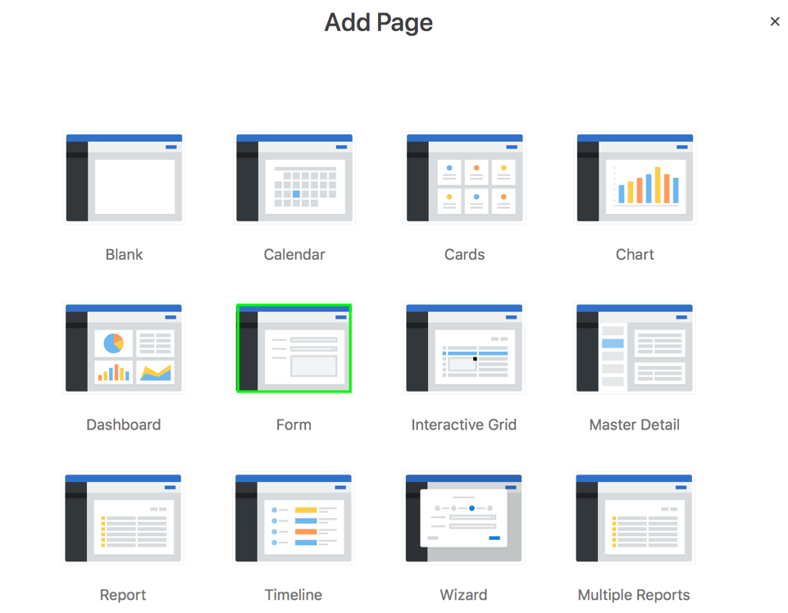
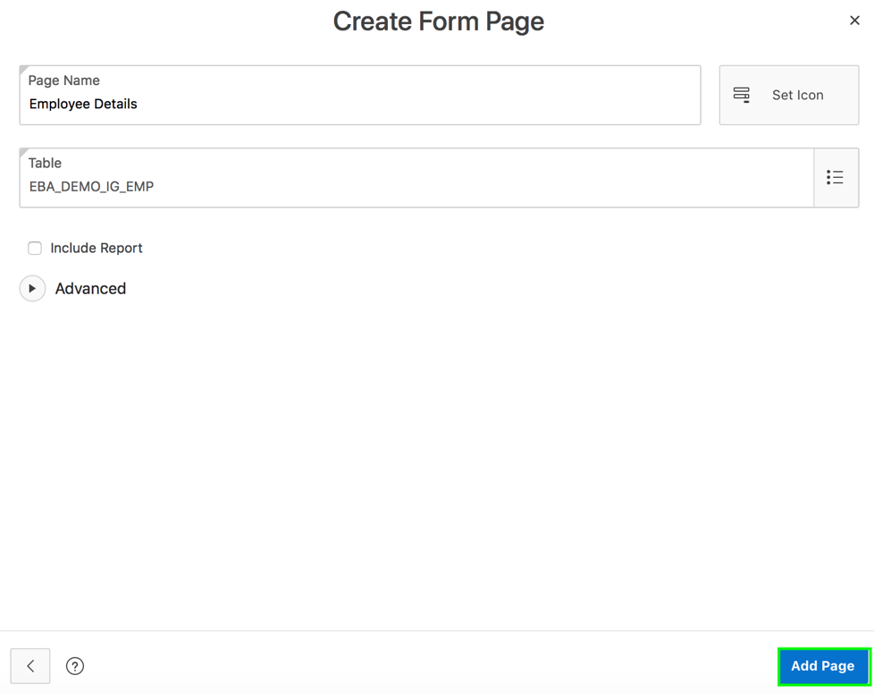
Creating a Form Using the Create Application Wizard
Notes:
The slide shows the steps involved in adding a form page when you create a database application. To create a form using the Create Application wizard, perform the following steps:
On the Workspace home page, click the App Builder icon.
Click Create.
Click New Application.
For Name, enter the name used to identify the application.
For Appearance, accept the default Theme Style and menu layout (Vita, Side Menu), or change it by clicking the Set Appearance icon adjacent to the Appearance field.
You want to add a form. Click Add Page and then select Form.
On the Create Form Page:
Page Name: Enter a name for the page
Table: Select the table for the form. In the slide example, you select the EBA_DEMO_IG table.
Include Report: Select the Include Report check box to create a report and form. The first page is an interactive report. Each row provides a link to a form where users can update a record.
Click Add Page.
Under Features, select features to include with the application.
Under Settings, specify settings used to generate this application.
Click Create Application. Now, run the application.

Slide 9
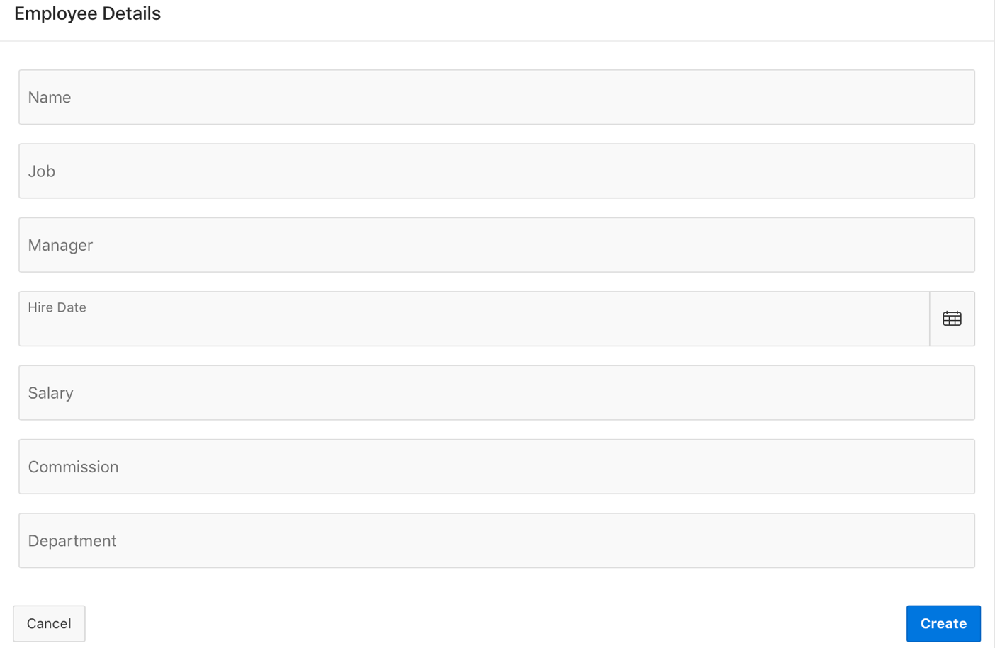
Creating a Form: Example
Notes:
Both the Create Application Wizard and Create Page Wizard support the creation of a simple form. The main difference between these two wizards is that the Create Page Wizard offers more customization and data source options. Using the Create Page Wizard, the developer has the option to select a data source (that is, Local Database, REST Enabled SQL Service, or Web Source Module). Additionally, the developer can also specify whether to include and configure breadcrumbs or a navigation menu and select the columns and the order in which they display.
The slide shows the Employee Details form which is created on the EBA_DEMO_IR_EMP table using the create page wizard. A form basically enables users to update a single row in a database table. The wizard allows you to choose a table on which to build a form. The wizard creates the Create and Cancel buttons on the page. You can create a new row in the table by entering the details in this form and clicking the Create button. The form inserts data into the table and you are redirected to the page that you specified while creating the form. If you click Cancel, you are returned to the page that you specified while creating the form.
Using ROWID: For the DML operations to function properly in a form, each row in a table should be uniquely identifiable. You generally specify a primary key for a table. A primary key can be either a single column or a combination of two or more columns in a table. The Create Form wizards in Application Express allow you to specify a maximum of two columns for a primary key. If your table does not have a primary key or if the primary key is a combination of more than three columns, then you must use ROWID. ROWID is a pseudo column, that uniquely identifies a row in a table. In the Create Form wizard, the default Primary Key Type is Managed By Database (ROWID).

Slide 10
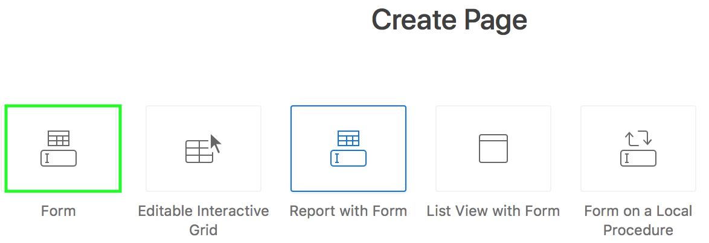
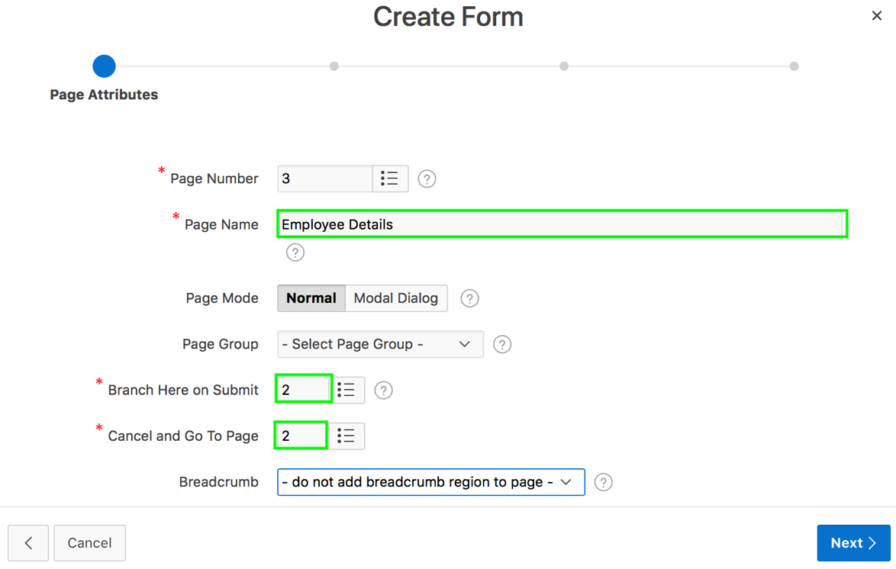
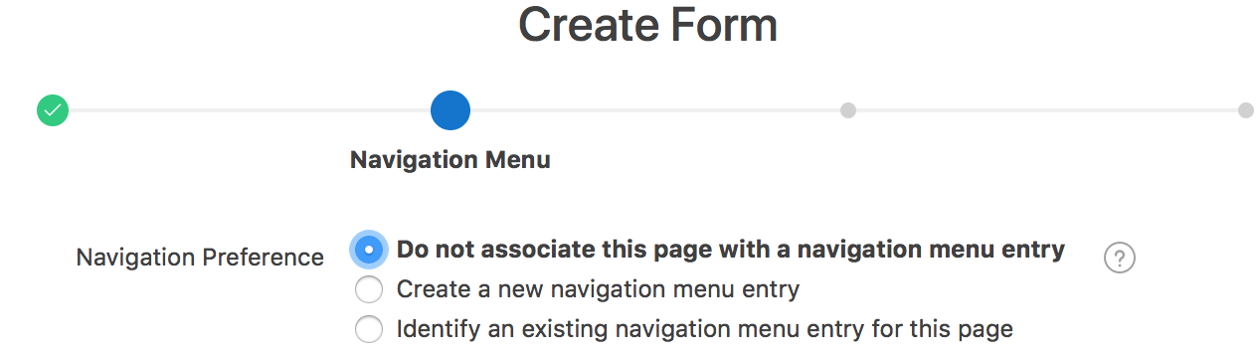
Creating a Form: Example
1
2
3
Notes:
The slide shows steps to create a form on a table. Perform the following steps:
First, access the "Form on a Table" wizard. On your application home page, click Create Page, select Form and then select Form again.
On the Page Attributes dialog, enter a name for Page Name. Then, select an option for Page Mode. You can either select Normal or Modal Dialog. In the slide example, you select Normal. For Branch Here to Submit, select a page to branch to after the page processing is complete. Select a page that you should be redirected to if you click the Cancel button on the form. In the slide example, you select Page 2 which is a interactive report that you already built using the EBA_DEMO_IR_EMP table. Click Next.
Select an option for Navigation Preference and click Next. In the example, you accept the default.
The example shows creating a form as a normal page. Instead of choosing Normal, you can choose Modal Dialog for Page
Mode. A modal dialog is an overlay window positioned within the viewport, which remains active and focused until the end
user dismisses (closes) it. The underlying page is greyed out and the end user is prevented from interacting with the rest
of the page until the dialog is closed.
You cannot run dialog pages directly from Page Designer. You can review such page by running a page that launches the
dialog.

Slide 11
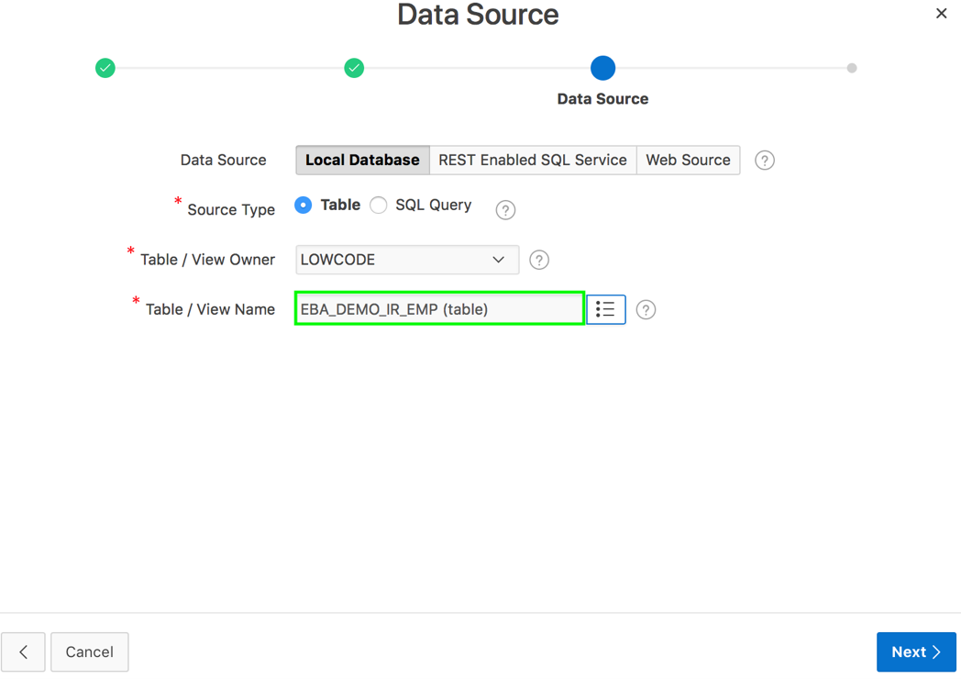
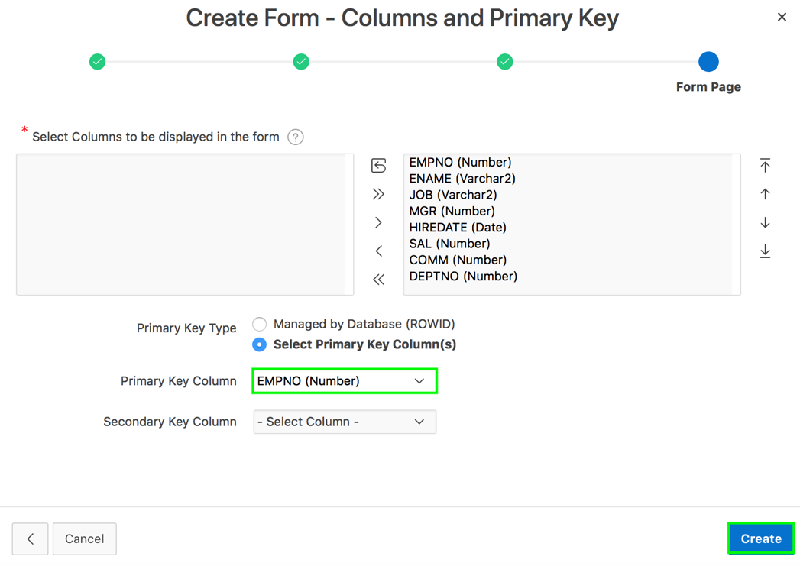
Creating a Form: Example
4
5
Notes:
In the Data Source dialog, select the data source for the form. You can choose either a local or an external data source:
Local Database: Data is sourced from the local database
REST Enabled SQL Service: Data is sourced from a remote database, where the connection is defined using REST Enabled SQL. To create or maintain REST Enabled SQL references, navigate to Shared Components > REST Enabled SQL
Web Source: Data is sourced from a RESTful web service defined using Web Source Modules. To create or maintain Web Source Modules, navigate to Shared Components > Web Source Modules
In the slide example, you choose Local Database. Select the table or the SQL Query on which the form will be based. In the slide example, you select Table for Source Type and then select EBA_DEMO_IR_EMP for Table / View Name. Click Next.
Select the columns to include in the form. Select an option for Primary Key Type and click Create. In the slide example, you select Select Primary Key Column(s) for Primary Key Type. Then, you select EMPNO for Primary Key Column.
The form is now created. Click Save and Run Page.

Slide 12
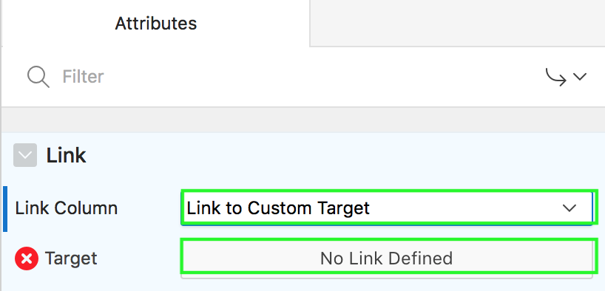
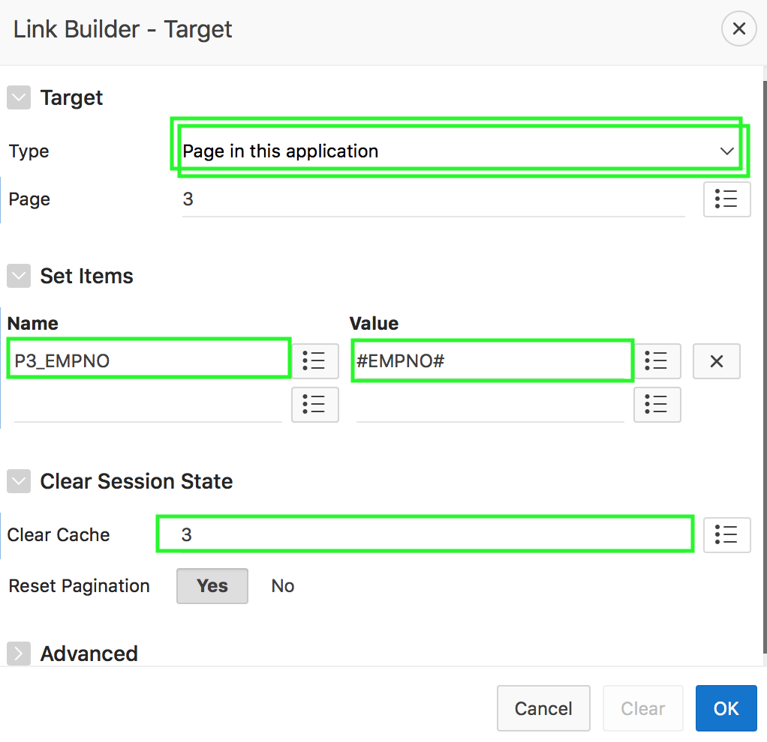
Linking a Report to a Form
1
2
Notes:
The slide example shows how to link an interactive report to a form. When you create a "Report with Form," the wizard automatically creates the required report and form and links between them. You can also link interactive and classic reports to existing forms. In the slide example, you link an interactive report to the form that you just created in the previous slide. For this example, you already have an interactive report built using the EBA_DEMO_IR_EMP table.
To link a report to a form, perform the following steps:
View the report page in page designer.
Under Rendering, select Attributes.
Then, locate Link in the right pane and select Link to Custom Target for Link Column.
Click Target and a dialog page opens.
In the Link Builder – Target dialog box:
Select the target form page. For example, in the slide, select the Employee Details page, Page <n>.
Select the item and value that is to be passed with the link. For example, in the slide, you select P<n>_EMPNO for Name and #EMPNO# for Value
Click OK.
Now, click Save. Then, click Save and Run Page.

Slide 13
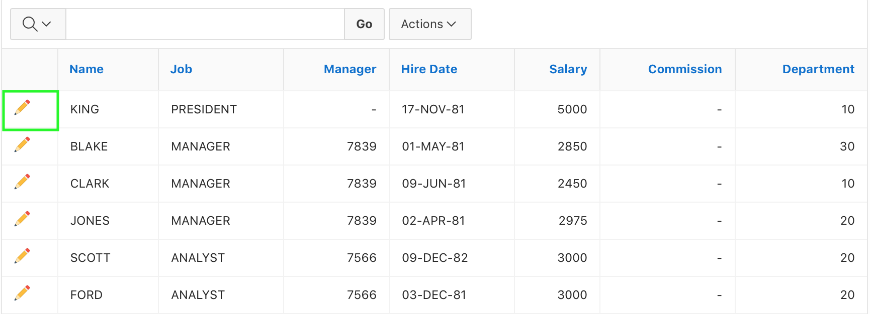
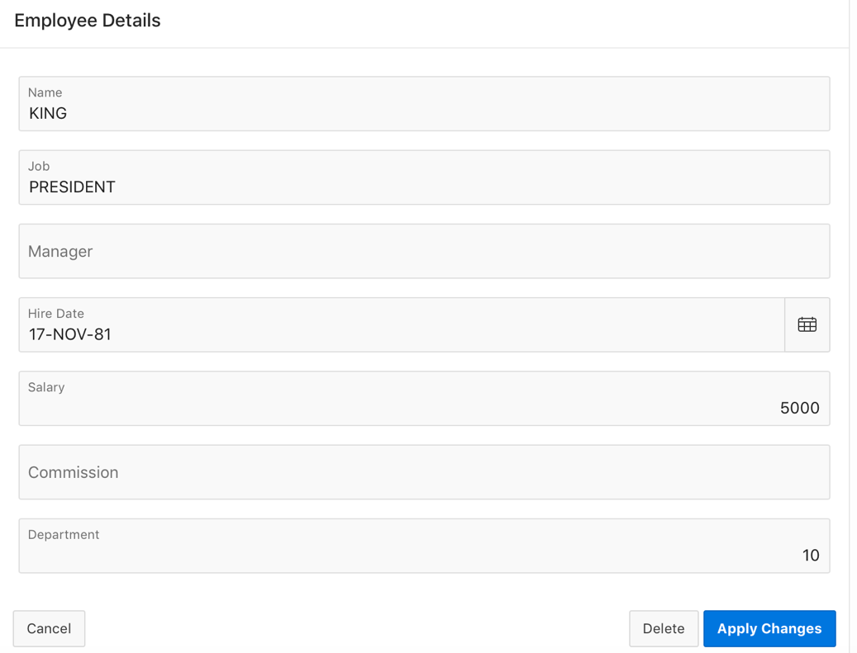
Linking a Report to a Form
3
Notes:
Click the edit icon for any employee and you see the Employee Details form displayed.

Slide 14
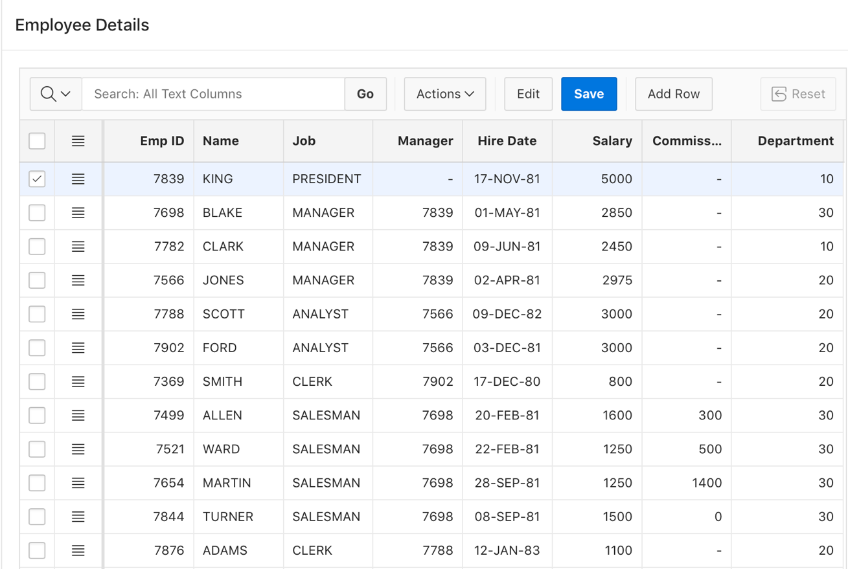
Creating an Editable Interactive Grid
Notes:
In an editable interactive grid, users can add to, modify, and refresh the data set directly on the page. Editable interactive grids expand the functionality of regular interactive grids to enable users to more directly update a grid’s structure and contents. Users can add and delete rows, edit cell contents, and refresh the grid with the latest updates. The slide shows the Employee Details editable interactive grid created using the Create Page wizard. In the next slide, you learn the steps to create an editable interactive grid.
An Interactive Grid - Automatic Row Processing (DML) process is added by default when an Interactive Grid is made editable.
Key features of editing an Editable Interactive Grid:
The grid is in navigation mode where arrow keys move from cell to cell. To enter edit mode press the Edit button or double click or press Enter key or F2 key in a cell. To exit edit mode press the Edit button or press Escape key in a cell.
In edit mode the [Shift] Tab key moves to the previous or next cells. The [Shift] Enter key moves to the same column in the previous or next row.
Edit controls such as radio groups or text areas that don't fit in a cell are displayed in a floating popup. The popup can be moved or collapsed to see the data under it. The Ctrl+F6 key will collapse or expand the floating popup.
Use the Delete key to delete the selected rows. Use the Insert key to add a row.
The Actions menu allows you to perform actions on the row such as Delete or Duplicate. The menu in the header is a selection actions menu that acts on the current selection.
The Copy Down, Fill, and Clear actions work with row or cell range selection. Use Actions > Selection > Cell / Row Selection to toggle selection mode or press F8 key. Copy Down requires at least 2 rows selected.
Editing is also supported in Single Row View. All edits are stored locally until you press the Save button. If you try to leave the page while there are unsaved changes you will be warned.
Any action that causes refreshing the data such as changing a filter or sorting will warn if there are unsaved changes. Pagination does not affect changes.

Slide 15
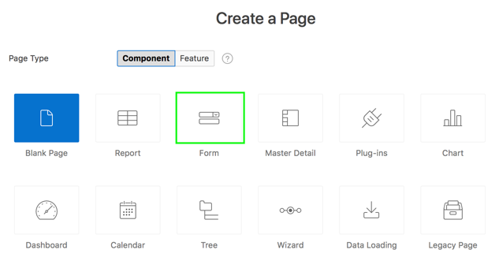
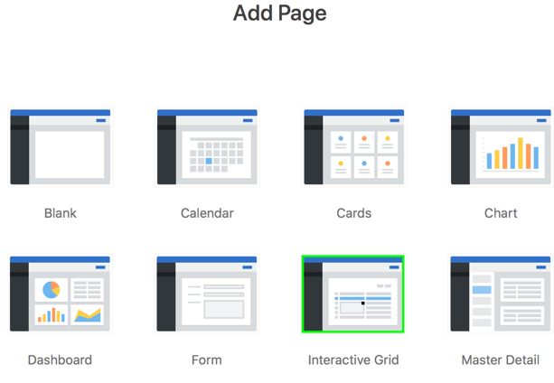
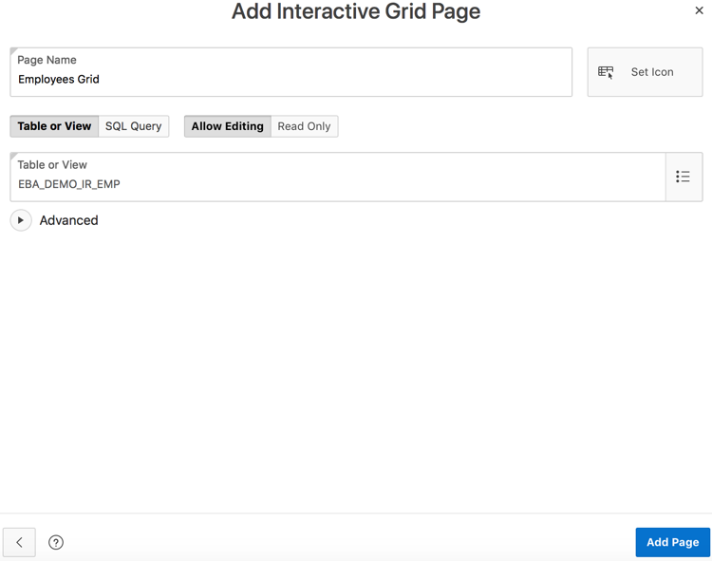
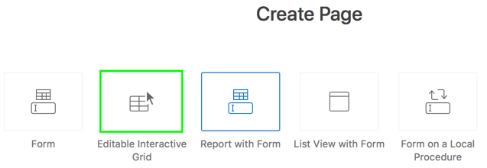
Creating an Editable Interactive Grid: Different Wizards
Create Page Wizard
Create Application Wizard
Notes:
The slide shows the two different wizards that allow you to create an Editable Interactive Grid in Application Express: Create Page wizard and Create Application wizard.
To directly create an editable interactive grid when you create a database application, perform the following steps:
On the Workspace home page, click the App Builder icon.
Click Create.
Click New Application.
For Name, enter the name used to identify the application.
For Appearance, accept the default Theme Style and menu layout (Vita, Side Menu), or change it by clicking the Set Appearance icon adjacent to the Appearance field.
You want to add a form. Click Add Page and then select Interactive Grid.
On the Add Interactive Grid Page:
Page Name: Enter a name for the page
Table or View : Select the database object for the grid. Alternatively, if you select Query, enter a valid SQL statement which returns distinct columns.
Notice that the Allow Editing tab is selected by default.
Click Add Page.
Under Features, select features to include with the application.
Under Settings, specify settings used to generate this application.
Click Create Application. Now, run the application.
In the Create Page wizard, you first select Form for Page Type and then you select an Editable Interactive Grid.
Alternatively, in the Create Page wizard, you select Report for Page Type and then select Interactive Grid. To create an editable interactive grid, in the Report Source dialog of the wizard, you can then set Editing Enabled to Yes. You already learned how to create an interactive grid in the Developing Reports lesson. In the next slide, you see an example and learn the steps to directly create an editable interactive grid using the Create Page wizard.

Slide 16
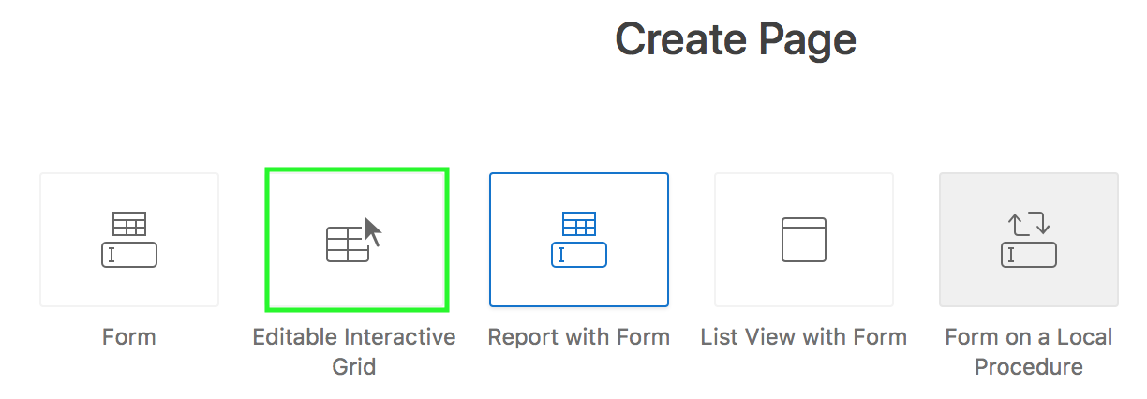
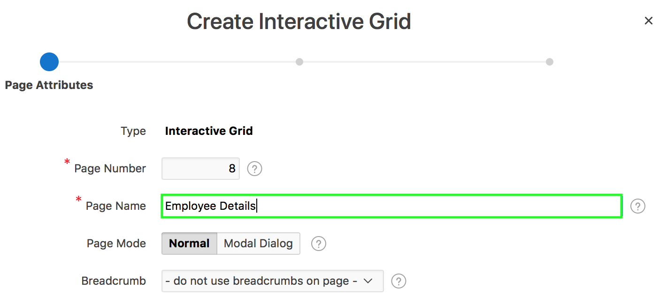
Creating an Editable Interactive Grid: Steps
1
2
Notes:
The slide shows steps to create an editable interactive grid using the Create Page wizard. Perform the following steps:
On your application home page, click Create Page, select Form and then select Editable Interactive Grid.
On the Page Attributes dialog, specify the interactive grid page name, accept the remaining defaults and click Next.

Slide 17
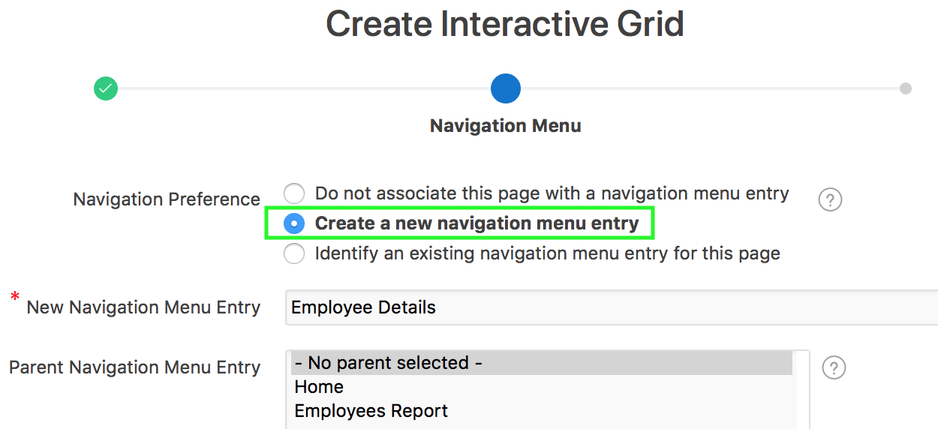
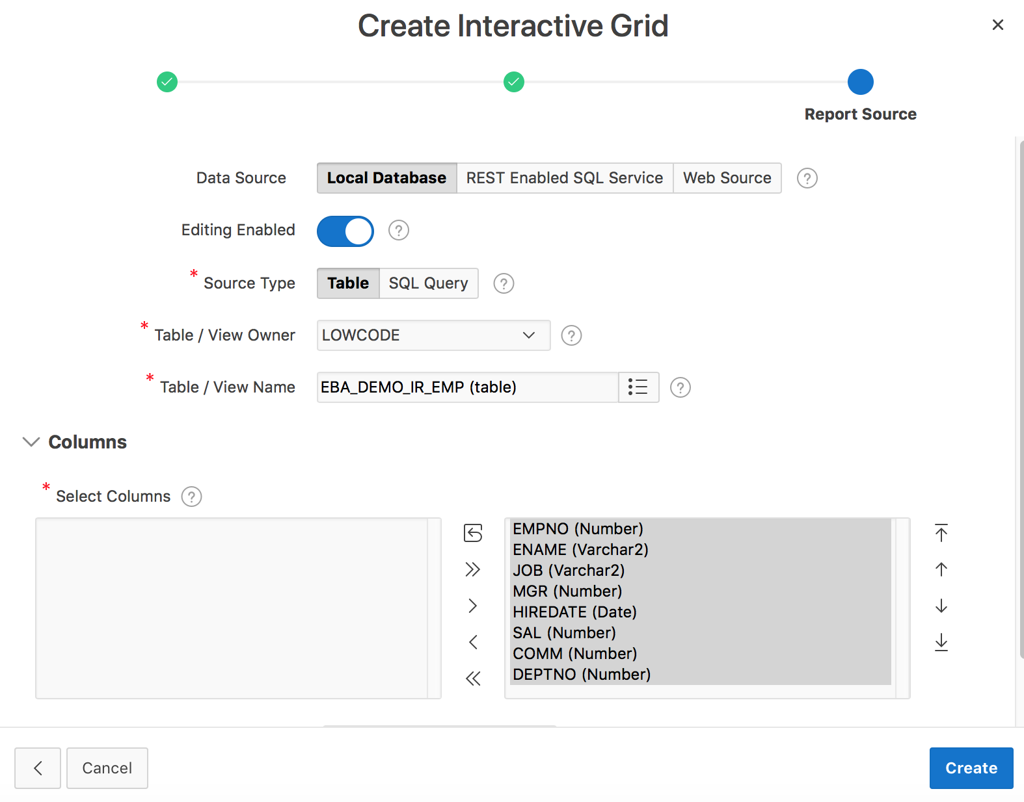
Creating an Editable Interactive Grid: Steps
3
4
Notes:
Specify your navigation preference and click Next. In the slide example, you select Create a new navigation menu entry.
On the Report Source dialog, the data source type can be local database, REST Enabled SQL Service or Web Source. The default selection is Local Database. Notice that the default selection for Editing Enabled is Yes. Select the following:
Source Type: You can either select Table or SQL Query. In the slide example, select Table.
Table/View Name: Select the table that is the source for your interactive grid. In the slide, select EBA_DEMO_IR_EMP table.
For Primary Key Column, accept the default selection of ROWID.
Select the columns to include in the grid and click Create.
Now, save and run page.
Data Source type for the APEX component:
Local Database: Data is sourced from the local database.
REST Enabled SQL Service: Data is sourced from a remote database, where the connection is defined using REST Enabled SQL. To create or maintain REST Enabled SQL references, navigate to Shared Components > REST Enabled SQL.
Web Source: Data is sourced from a RESTful web service defined using Web Source Modules. To create or maintain Web Source Modules, navigate to Shared Components > Web Source Modules.

Slide 18
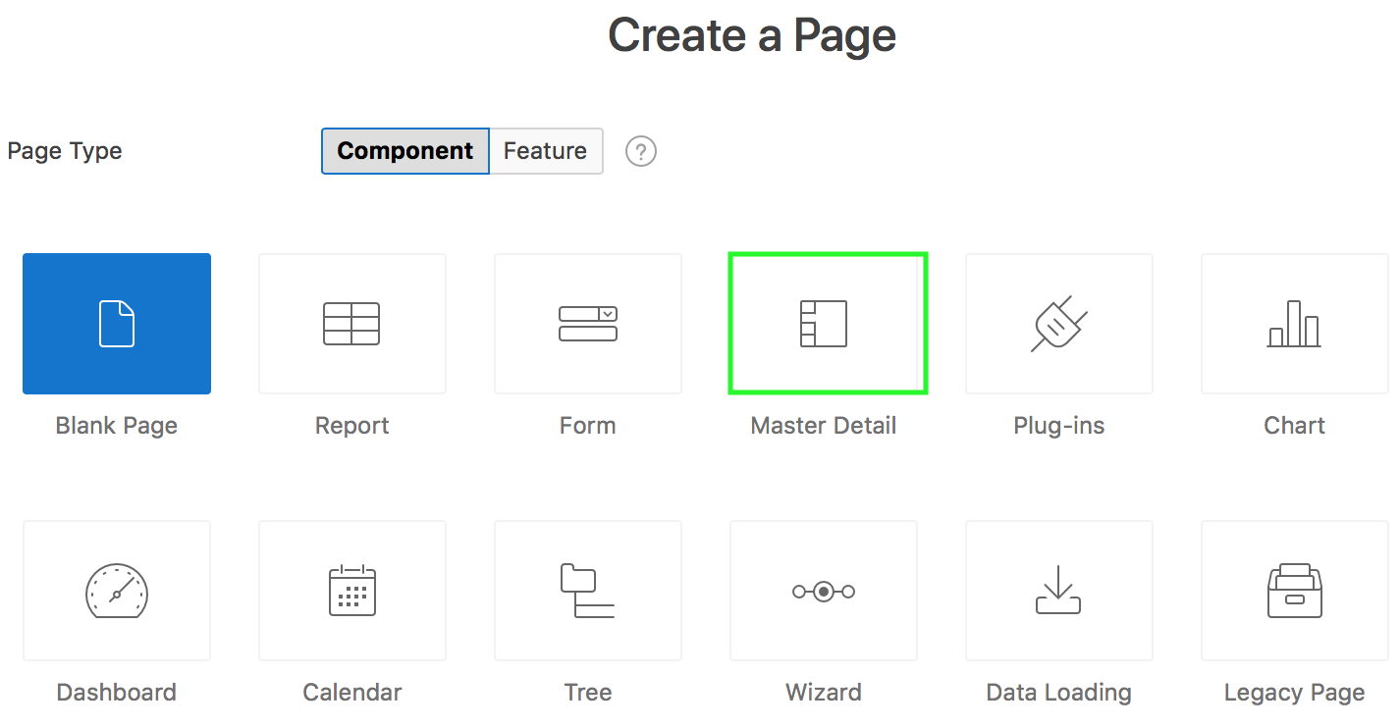
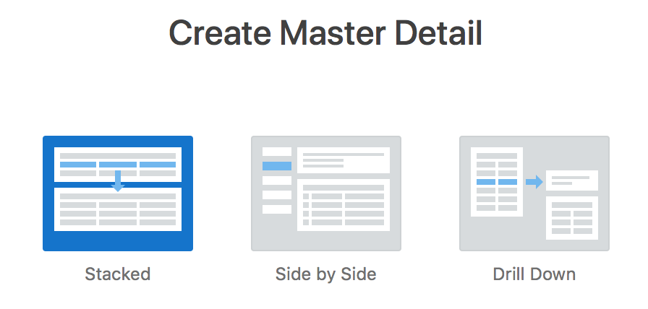
Understanding Master Detail Forms
Notes:
A master detail form reflects a one-to-many relationship between tables in a database. Typically, a master detail form displays a master row and multiple detail rows. When you create a master detail form using the Create Page or Create Application wizards, you choose the tables on which to build the master form and the detail form. Master detail form options include: Stacked, Side by Side, and Drill Down.
The slide shows the three options available when you choose Master Detail in the the Create Page wizard:
Stacked: Creates a single page master detail with editable interactive grids
Side by Side: Creates a single page master detail utilizing side by side layout and report regions with modal edit windows. The left side contains a master list to navigate to the master record. The right side contains the selected master record and the associated detail report.
Drill Down: Creates a two page master detail. The first page contains an interactive report for the master table. The second page features a standard form for the master and interactive grid for the detail.

Slide 19
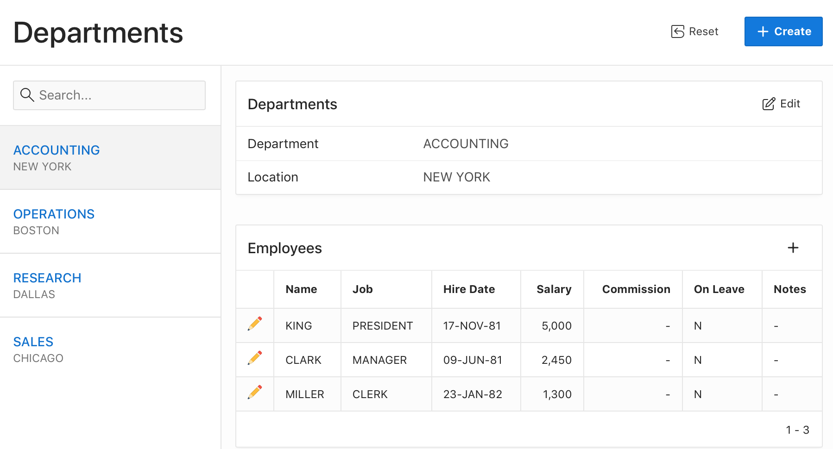
Creating a Side by Side Master Detail Form
Notes:
A Side by Side master detail form contains a single page master detail utilizing side by side layout and report regions with modal edit windows. The left side contains a master list to navigate to the master record. The right side contains the selected master record and the associated detail report(s). You can create Side by Side master detail with either Create Application Wizard or Create Page Wizard.
The slide example shows the master-detail regions on the same page. You can select a record from the master on the left to render the detail on the right without leaving the page.
You learn the steps to create a Side by Side Master Detail in the next slide.

Slide 20
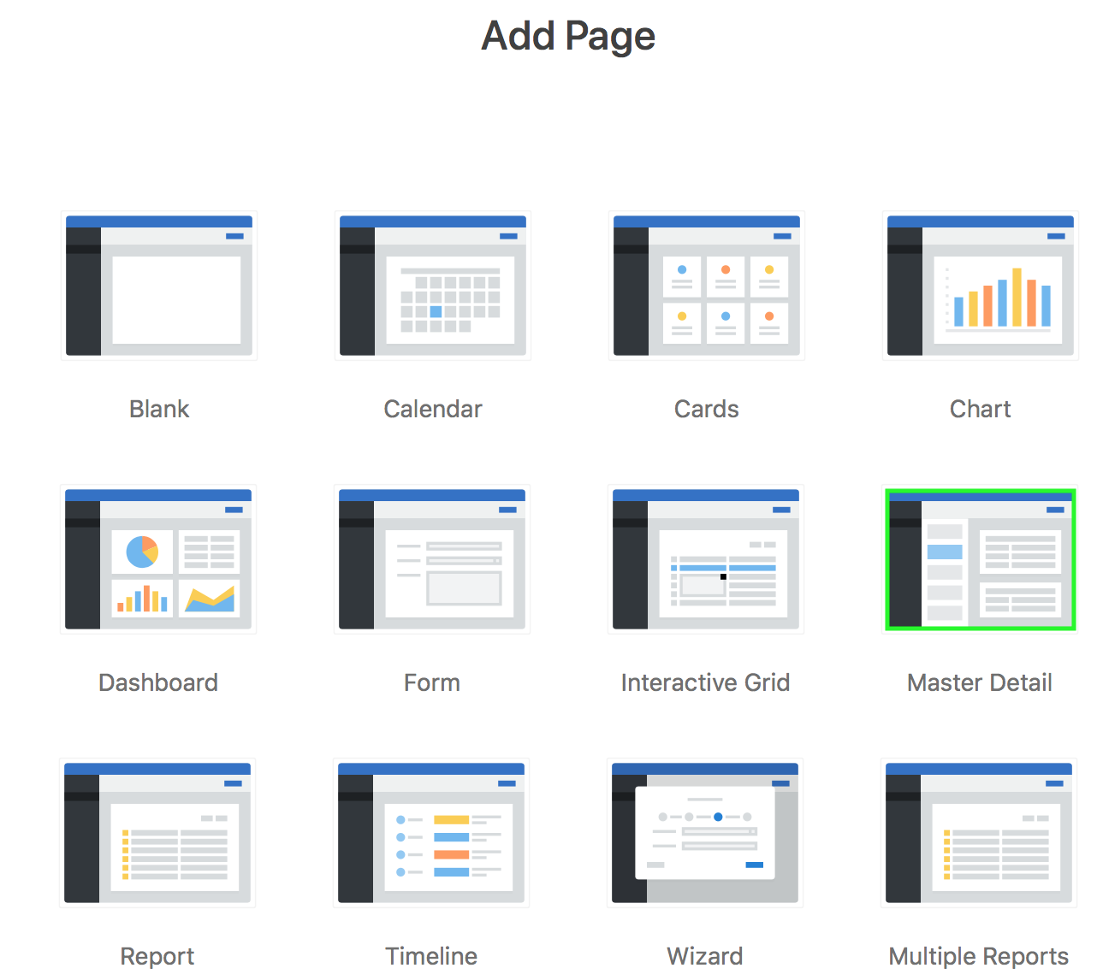
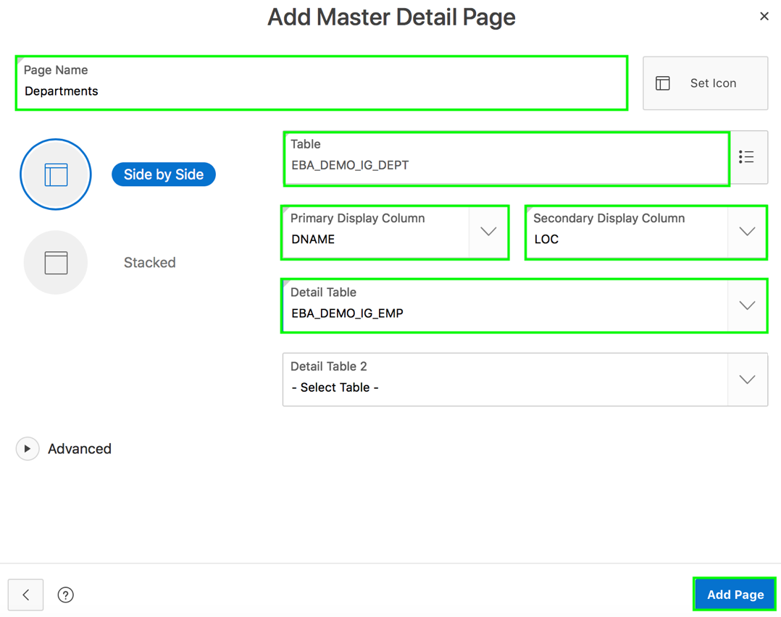
Creating a Side by Side Master Detail: Steps
Notes:
This slide shows how to create a Side by Side Master Detail using the Create Application wizard. Perform the following steps:
On the Workspace home page, click the App Builder icon.
Click Create.
Click New Application.
For Name, enter the name used to identify the application.
For Appearance, accept the default Theme Style and menu layout (Vita, Side Menu), or change it by clicking the Set Appearance icon adjacent to the Appearance field.
You want to add a master detail form. Click Add Page and then select Master Detail.
On the Add Master Detail Page:
Page Name: Enter a name for the page
Page Type: Select Side by Side. This Creates a single page (or Side by Side) master detail with a master table and detail table. The left side contains a master list to navigate to the master record. The right side contains the selected master record and the associated detail report
Table: Select the master table. In the slide, you select EBA_DEMO_IG_DEPT.
Primary Display Column: Select the column to display as primary column in the report to navigate to a different master record.
Secondary Display Column: Select the column to display as secondary column in the report to navigate to a different master record.
Detail Table - Select the detail table for the page. In the slide, you select EBA_DEMO_IG_EMP. Note: Only one detail table (editable interactive grid) can be added using the wizard. Additional detail tables can easily be added post-generation.
Click Add Page.
Under Features, select features to include with the application.
Under Settings, specify settings used to generate this application.
Click Create Application. Now, run the application.

Slide 21
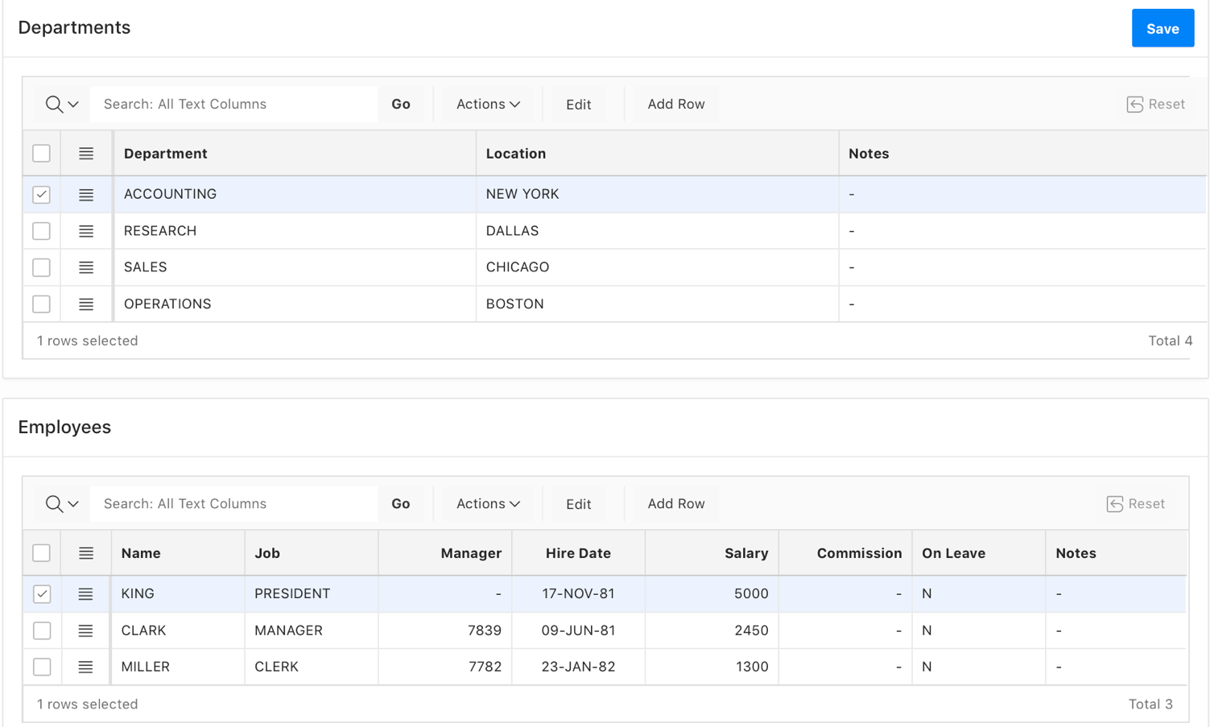
Creating a Stacked Master Detail Form
Notes:
A stacked master detail features two editable interactive grids based on two related tables or views. Users select a row in the master grid to update the detail grid. Developers can create a stacked master detail form with either the Create Application wizard or the Create Page wizard. In the Create Application wizard, you click Add Page and then select Master Detail. Then, on the Add Master Detail page, you select Stacked. In the Create Page wizard, you first select Master Detail for Page Type and then select Stacked.
The slide example displays master detail interactive grids on the same page. The user has option of interacting with either the master or the detail without leaving the page. In the slide example, a user selects a department on the master grid to view details of the employees corresponding to that department in the detail grid.
You learn the steps to create a Stacked Master Detail in the next slide.

Slide 22
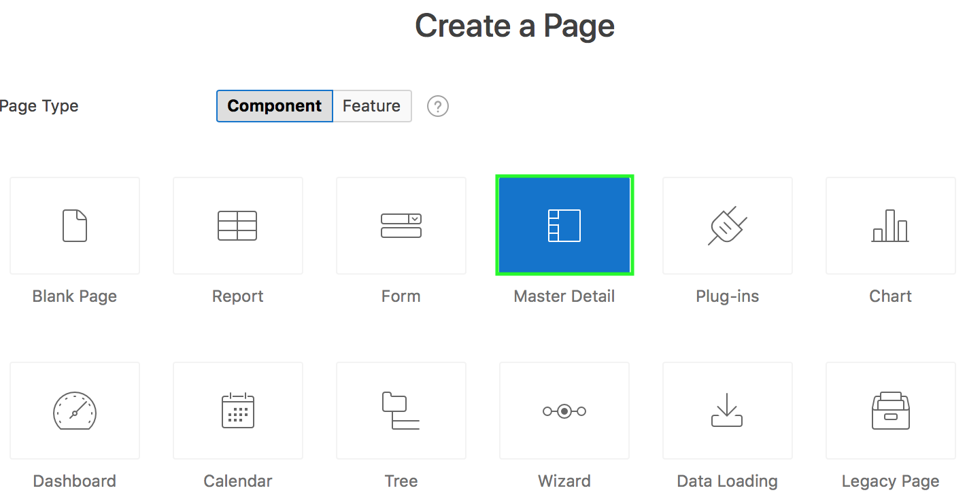
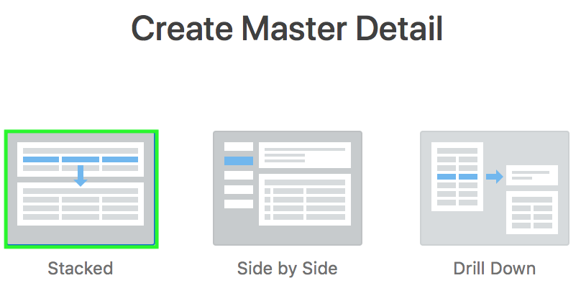
Creating a Stacked Master Detail: Steps
1
2
Notes:
This slide shows how to create a Stacked Master Detail using the Create Page wizard. Perform the following steps:
Navigate to your application home page and click Create Page. Select Master Detail and then click Next.
On the Create Master Detail page, select Stacked and click Next.

Slide 23
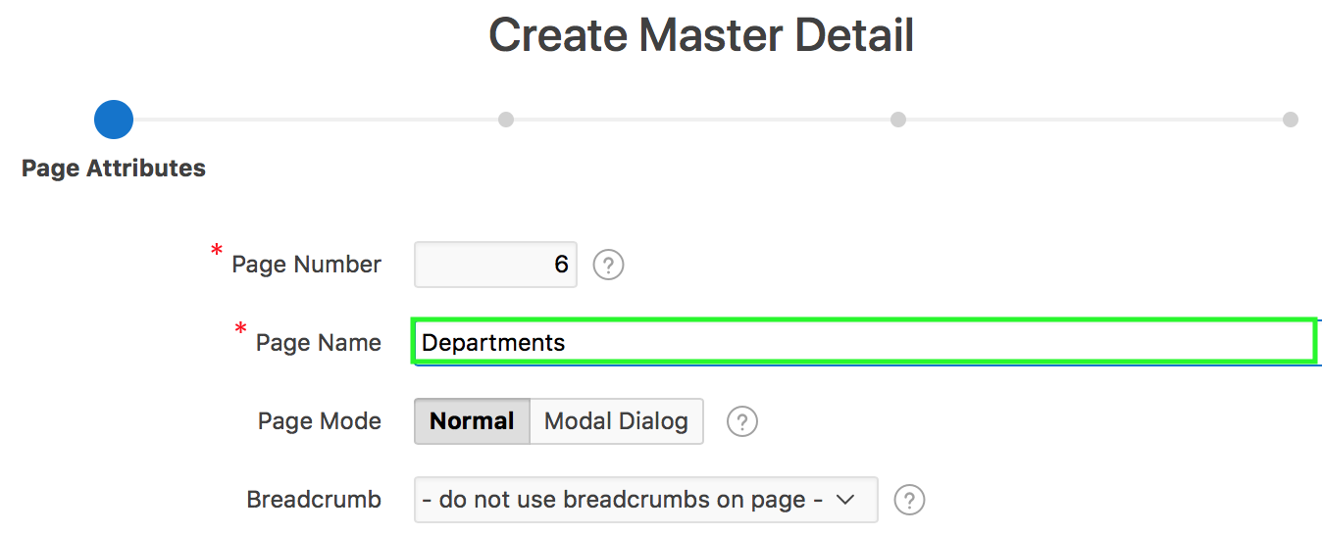
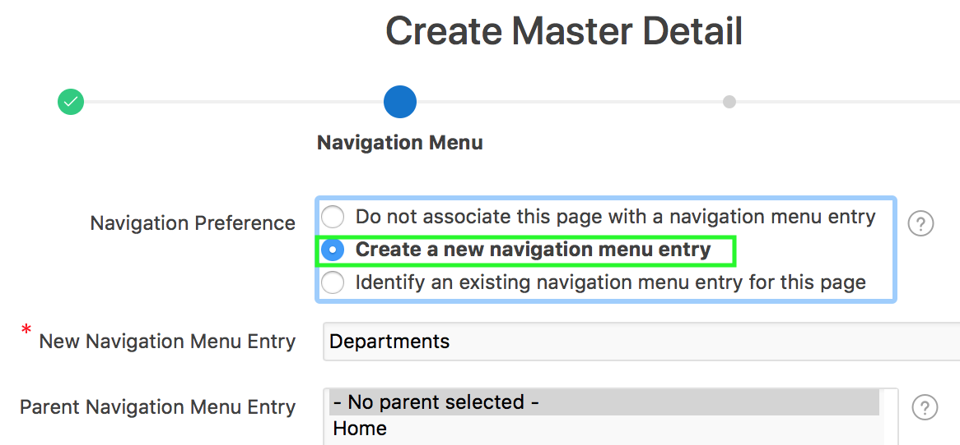
Creating a Stacked Master Detail: Steps
3
4
Notes:
On the Page Attributes page, enter a name for Page Name, accept the remaining defaults and click Next.
For Navigation Menu, specify your navigation preference. In the slide example, you select Create a new navigation menu entry. Accept the defaults, and click Next.

Slide 24
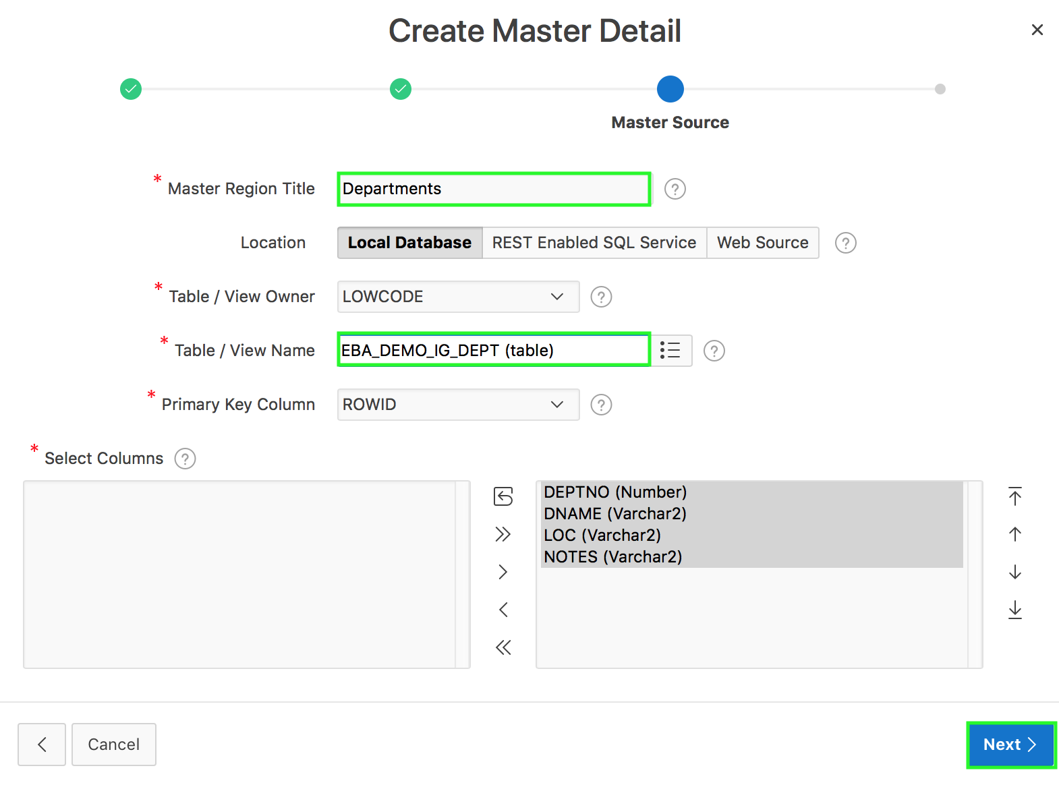
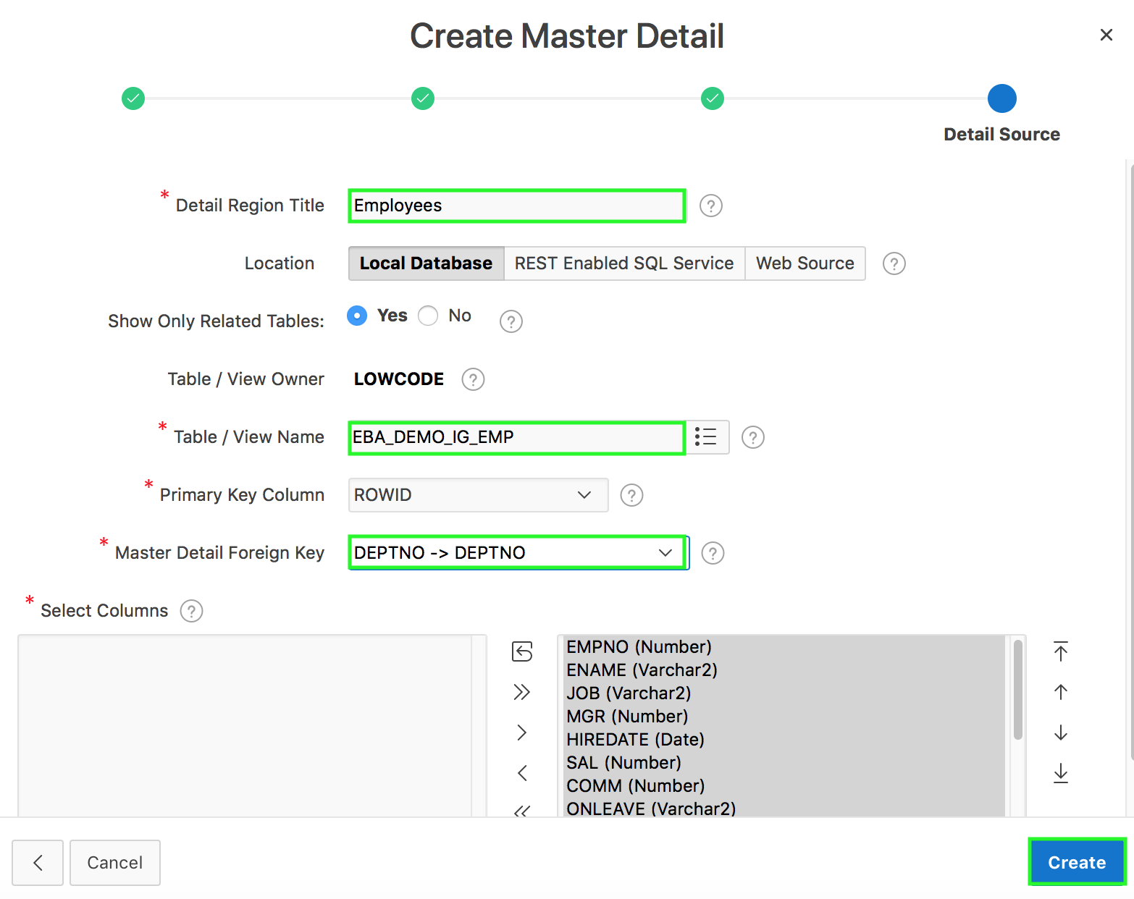
Creating a Stacked Master Detail: Steps
5
6
Notes:
For Master Source:
Master Region Title: Enter a region title for the master region. In the slide example, you enter Departments
Location: Data source type can be local database, REST Enabled SQL Service or Web Source. In the slide, you accept the default Local Database.
Table / View Name: Select the table or view on which the grid will be based. In the slide example, you select EBA_DEMO_IG_DEPT
Primary Key Column: Select the name of the column that uniquely identifies a row in the table
Select Columns: Select all the columns to be displayed.
Accept the remaining defaults and click Next.
For Detail Source:
Detail Region Title: Enter a region title for the detail region. In the slide example, you enter Employees
Location: Data source type can be local database, REST Enabled SQL Service or Web Source. In the slide, you accept the default Local Database.
Table / View Name: Select the table or view on which the grid will be based. In the slide example, you select EBA_DEMO_IG_EMP
Primary Key Column: Select the name of the column that uniquely identifies a row in the table
Master Detail Foreign Key: Select the foreign key that relates between the master and detail tables.
Select Columns: Select all the columns to be displayed.
Accept the remaining defaults and click Create. Now, click Save and Run Page.

Slide 25
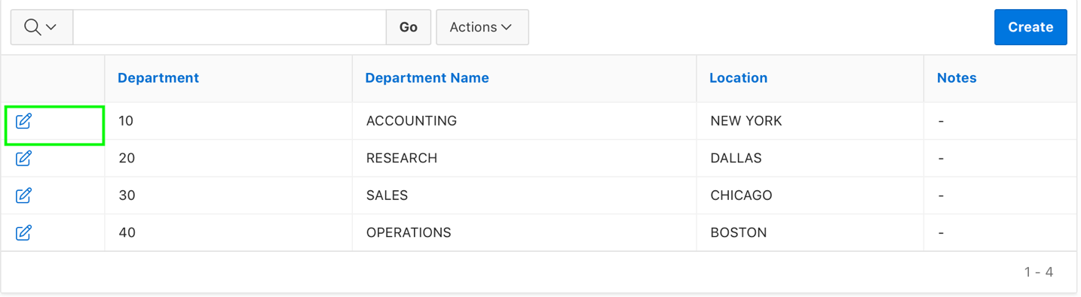
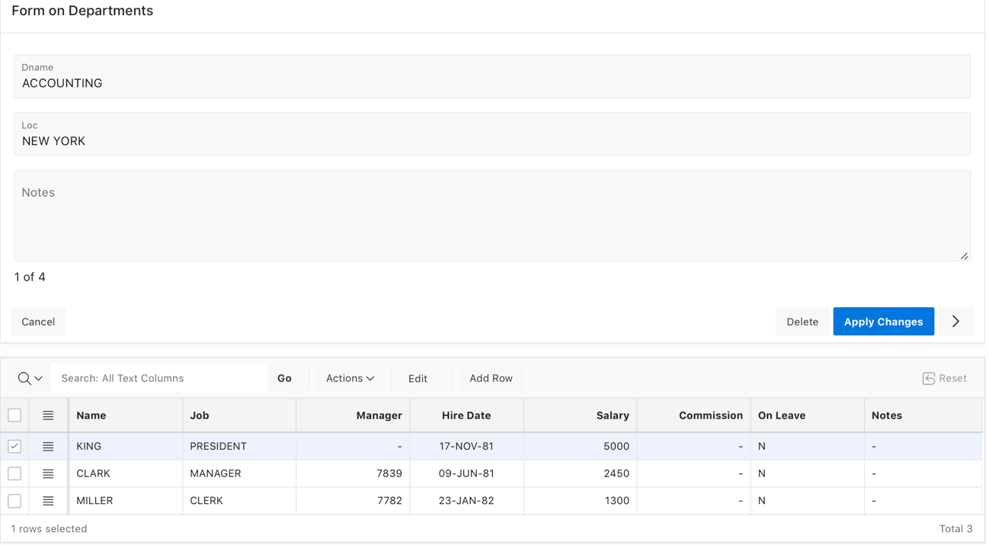
Creating a Two Page Drill Down Master Detail
Interactive Report for the master table
Standard form for the master and interactive grid for the detail
Notes:
A Drill Down master detail contains two pages based on two related tables or views. The first page contains an interactive report for the master table. Users click the Edit icon on the first page and edit details on the second page.
In the slide example, users click the Edit icon to access all employees within a department. The second page includes both a standard form (for the master) and editable interactive grid of employees. Developers can create a Drill Down master detail with the Create Page Wizard.

Slide 26
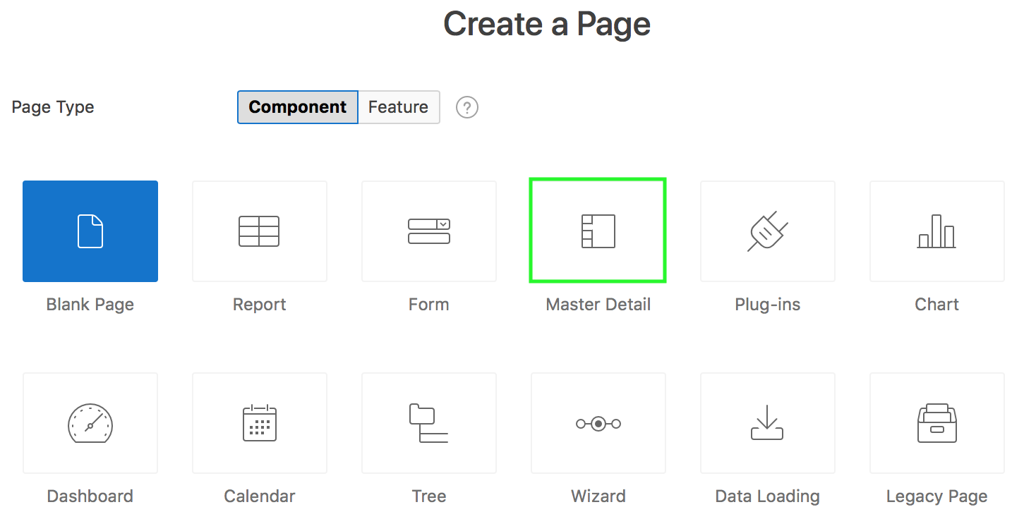
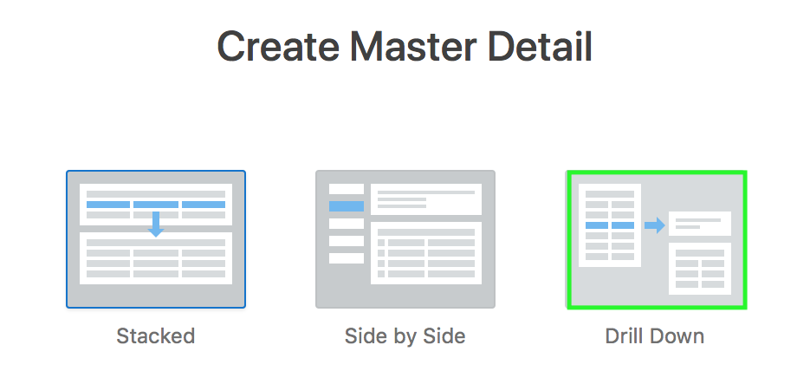
Creating a Two Page Drill Down Master Detail: Steps
1
2
Notes:
You use the Create Page Wizard to create a two page (or Drill Down) master detail form. The first page contains an interactive report for the master table. The second page features a standard form for the master and interactive grid for the detail. This slide shows how to create a two page drill down master detail using the Create Page wizard. Perform the following steps:
Navigate to your application home page and click Create Page. Select Master Detail and then click Next.
On the Create Master Detail page, select Drill Down and click Next.

Slide 27
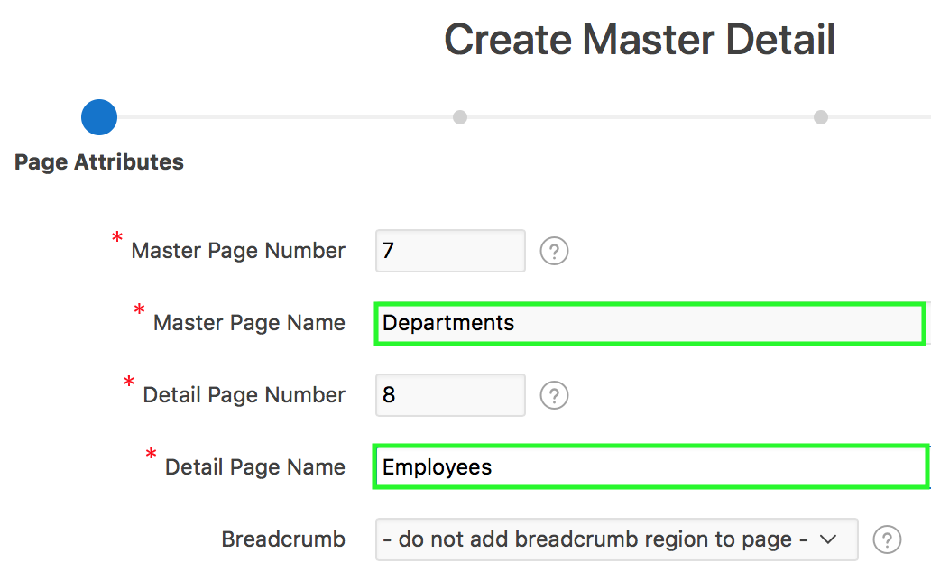
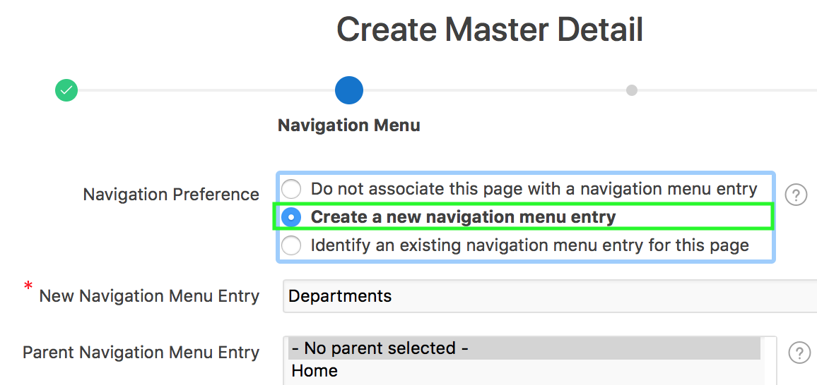
Creating a Two Page Drill Down Master Detail: Steps
3
4
Notes:
On the Page Attributes page, enter the name for the master page and detail page. The detail page will contain a form and editable interactive grid. Accept the remaining defaults and click Next. In the slide example, you enter Departments for Master Page Name and Employees for Detail Page Name.
For Navigation Menu, specify your navigation preference. In the slide example, you select Create a new navigation menu entry. Accept the defaults, and click Next.

Slide 28
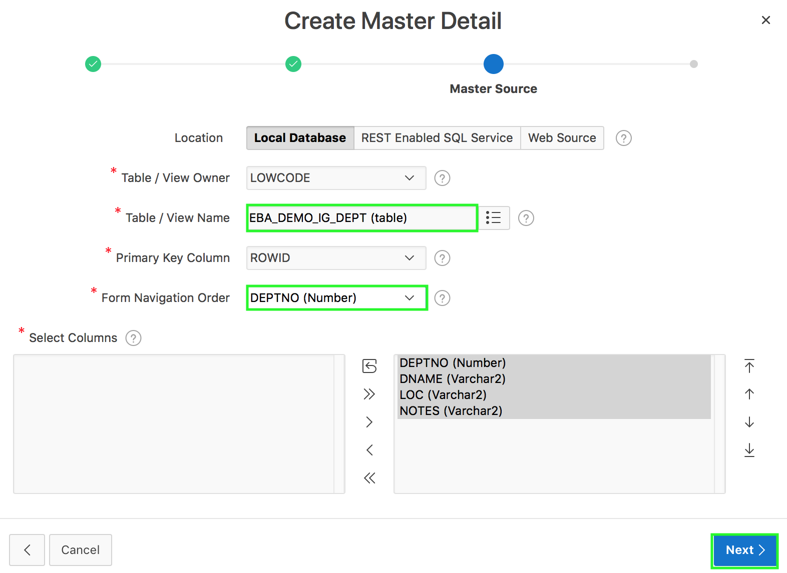
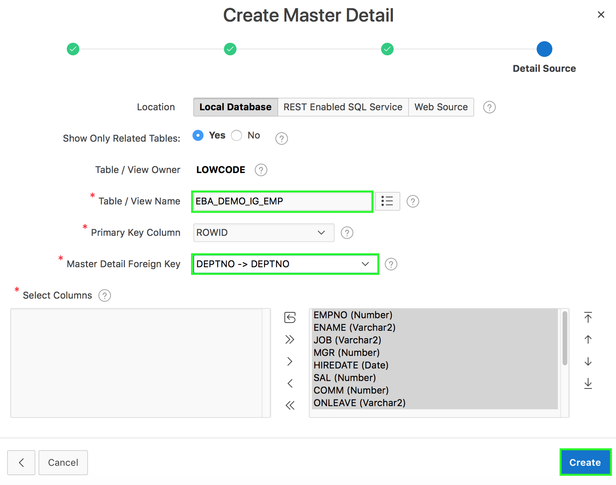
Creating a Two Page Drill Down Master Detail: Steps
6
6
5
Notes:
For Master Source:
Location: Data source type can be local database, REST Enabled SQL Service or Web Source. In the slide, you accept the default Local Database.
Table / View Name: Select the table or view on which the grid will be based. In the slide example, you select EBA_DEMO_IG_DEPT
Primary Key Column: Select the name of the column that uniquely identifies a row in the table. In the slide example, you accept the default ROWID.
Form Navigation Order: Select the navigation order column used by the previous and next buttons on the Detail Page, which navigates to a different master record. In the slide example, you select DEPTNO.
Select Columns: Select all the columns to be displayed.
Accept the remaining defaults and click Next.
For Detail Source:
Location: Data source type can be local database, REST Enabled SQL Service or Web Source. In the slide, you accept the default Local Database.
Table / View Name: Select the table or view on which the grid will be based. In the slide example, you select EBA_DEMO_IG_EMP
Primary Key Column: Select the name of the column that uniquely identifies a row in the table. In the slide example, you accept the default ROWID.
Master Detail Foreign Key: Select the foreign key that relates between the master and detail tables. In the slide example, you select DEPTNO -> DEPTNO.
Select Columns: Select all the columns to be displayed.
Accept the remaining defaults and click Create. Now, click Save and Run Page.

Slide 29
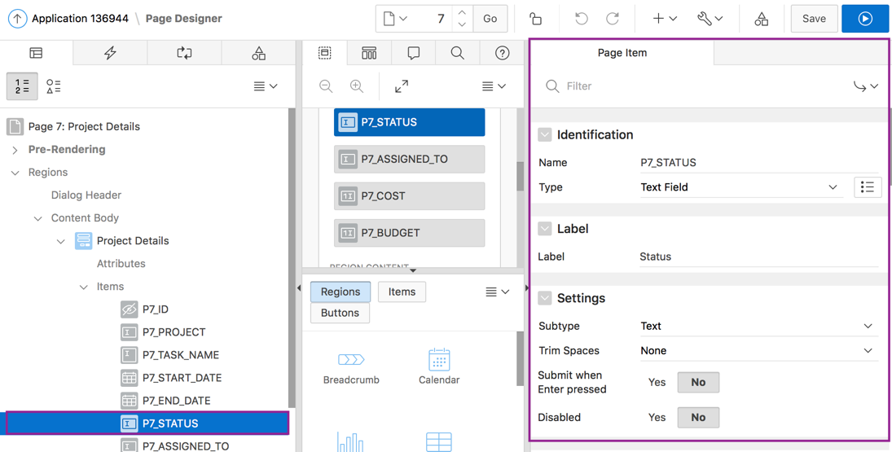
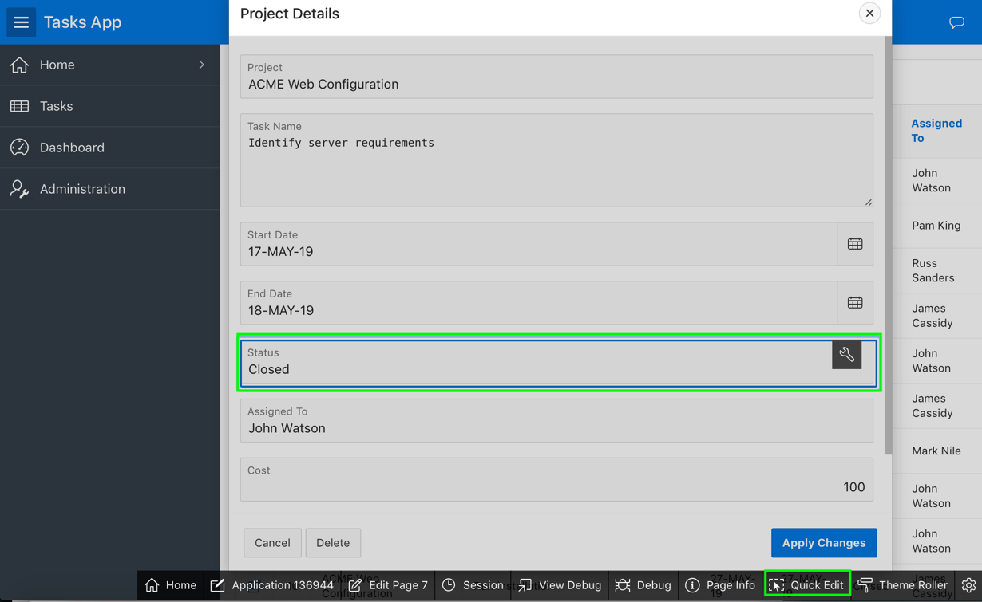
Editing a Form
Notes:
When working with forms, you might want to quickly change the format of a page item, or rename a label. When you run a page, modifying objects is easy with using Quick Edit. Use the Quick Edit control in the Runtime Developer toolbar and select a desired component to instantly access that component in Page Designer. When you click on the Quick Edit, it changes the cursor to a + symbol. Moving this + over the page highlights individual components such as regions, buttons, or items. When the page component you want to edit is highlighted, click that component and APEX automatically opens the page in page designer with the same component pre-selected. This makes it easy for you to edit the properties in the property editor and quickly make the desired changes.
In the slide example, you want to update the Status page item in the form dialog. In the Developer Toolbar, click Quick Edit and then click in the Status field. You are then navigated to the Page Designer. Notice that the P7_STATUS is pre-selected.

Slide 30

Modifying the Display Type of a Page Item
Notes:
The slide shows editing a form in page designer. In the slide example, P10_STATUS is an item of Text Field type. You want to change it to a Select List item type.
Under the Rendering tab, navigate to Regions and locate the form region. Expand Items node to see the list of page items. An item is part of an HTML form. An item can be a text field, text area, password, select list, check box, and so on. Item attributes affect the display of items on a page. For example, these attributes can impact where a label displays, how large an item is, and if the item will display next to or below the previous item. You learn more about page items and editing page items in the Creating Application Page Controls lesson.
Selecting an item in page designer displays the item attributes in the right pane. You can change the display type of a page item. To do this, perform the following steps:
View the form in page designer.
Select the page item under Rendering.
In the Property Editor, from the Type list, select the new display type that you want to apply to the item. For example, a Text Field can be changed to Select List.
Click Save.

Slide 31


Altering the Display Order of Page Items
Before reordering
After reordering
Notes:
The slide shows an example of reordering page items on the Employee Details form page. You want to move Rating immediately after Hire Date. The slide shows Employee Details page before and after reordering the page items on the form.
See the next slide to learn how to reorder page items in a form.

Slide 32

Altering the Display Order of Page Items
Drag and drop in Rendering
Drag and drop or Use Context Menu in Layout
Notes:
The slide shows an example of reordering page items on the Employee Details form page. You want to move Rating immediately after Hire Date.
To reorder items on a form, view the page in page designer. Expand Rendering and locate Items. Select the item you want to move, drag it and drop in the desired location. Alternatively, you can drag and drop the item in the Layout. You can even use the context menu in the Layout tab. For example, in the slide, you navigate to Layout in page designer. Select and right-click P<n>_RATING and select Move To > Employee Details > Items > P<n>_HIREDATE > After. This will place the P<N>RATING item immediately after the P<n>_HIREDATE item. Once you reorder items as required, click Save. Then, click Save and Run Page to see the changes implemented on the form page.

Slide 33
Summary
In this lesson, you learned how to:
Use the different wizards in Oracle APEX to create forms
Create an editable interactive grid
Create a simple form and link a report to this form
Create different types of master detail forms
Modify a form

Slide 34


Slide 35
Hands-on Lab

